Slide 1
Examples of Mechatronic Control System
Dr. Xiaoming Li

Slide 2
What's inside
A task schedular based framework for control system
Give concepts of mechtronic control system
Open loop and close loop (feedback control)
How to build real mechtronic system with Arduino

Slide 3
A time based task schedular
T1
T2
T3
T4
T5
...
Task Schuduler
Task dispatcher
Timer Signal

Slide 4
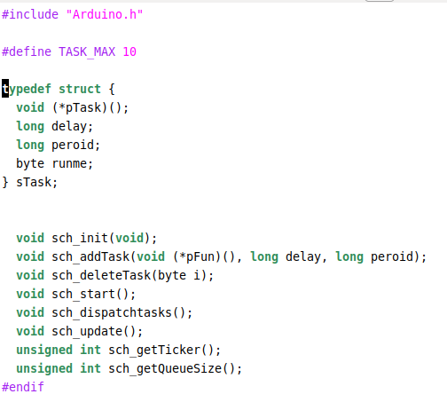
A timer based task schedular
Data Structure: Task
Task dispatch
Task schedule

Slide 5
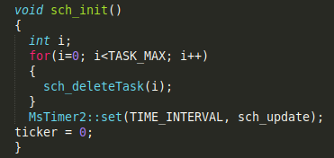
An implementation - Initialization

Slide 6
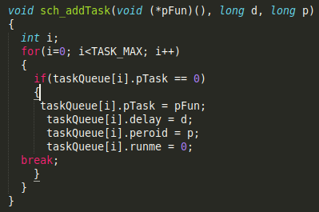
An implementation - addTask

Slide 7
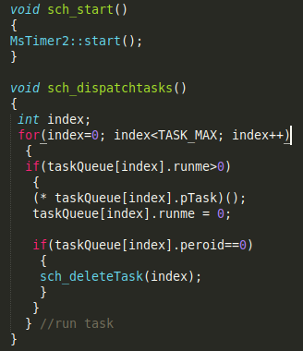
An implementation - Start & Dispatch

Slide 8
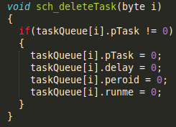
An implementatioin - Delete Task

Slide 9
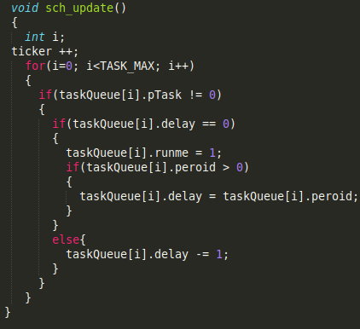
Schedule!

Slide 10
Example Program
#include <taskscheduler.h>
void setup() {
Serial.begin(9600);
pinMode(13, OUTPUT);
sch_init();
sch_addTask(do1, 0, 100);
sch_addTask(do2, 1, 100);
sch_start();
}
void loop() {
sch_dispatchtasks();
}
void do1()
{
digitalWrite(13, HIGH);
}
void do2()
{
digitalWrite(13, LOW);
}

Slide 11
Examples of Mechatronic Control System
Temperature control
DC motor control
DC motor feedback control

Slide 12
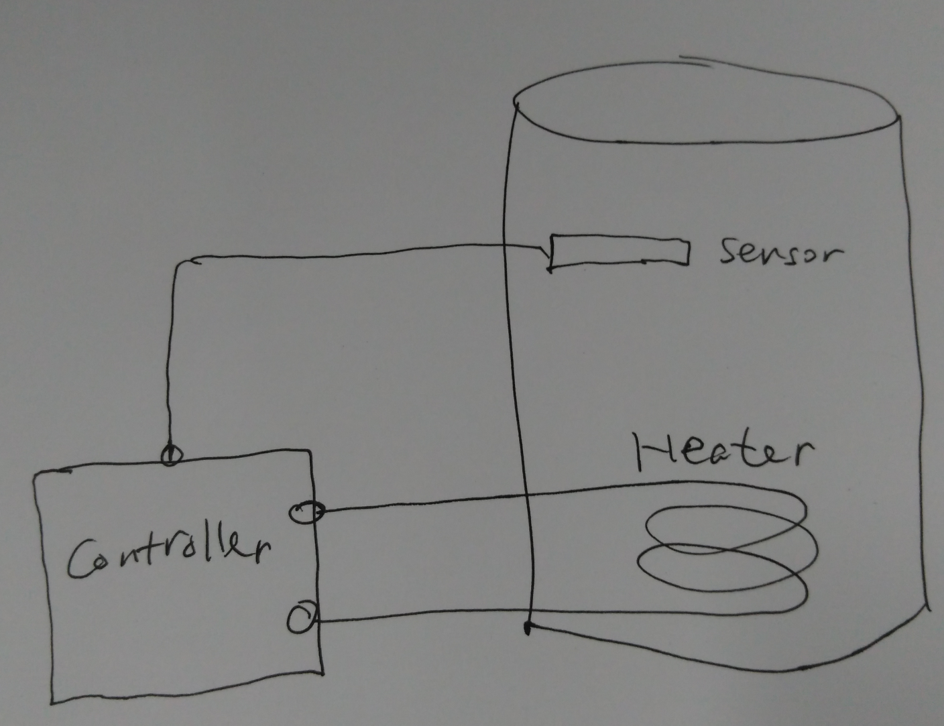
Temperature Control System

Slide 13
Temperature Control System
Sensor (Transducer)
Analog or Digital
Actuator (Transducer, Heater)
Controller
Interface (Hardware)
Algorithms (Software)
Bang-Bang Controller
PID controller
Hardware-software coupling

Slide 14
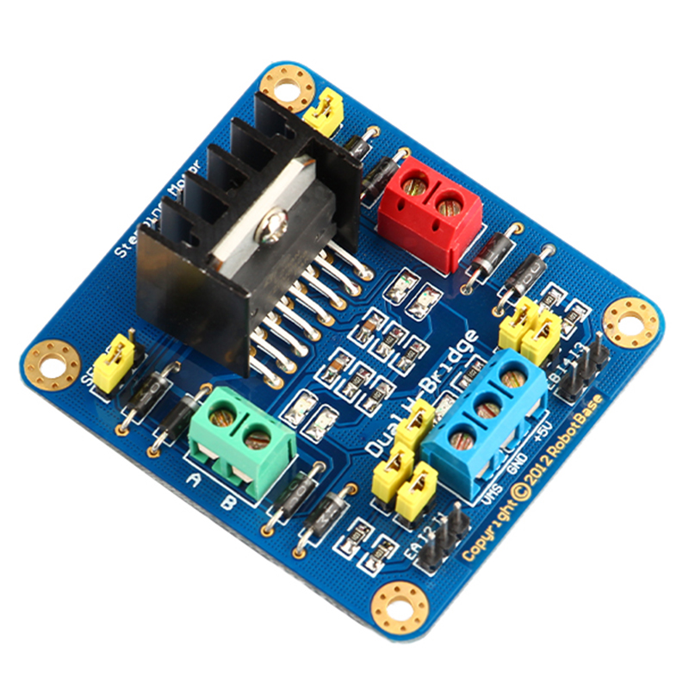
DC-Motor Control
How DC motor works
DC-motor driver
H-Bridge Circuit
PWM
Inteface
PWM <-> Speed
DO <-> Direction

Slide 15
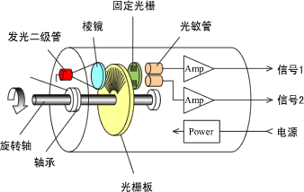
DC-Motor Control
Software Algorithms:
Open-loop:
analogWrite(pwmPort, speed)
digitalWrite(dirPort, dir)
Close-loop:
feedback control (PID)
Optical Encoder

Slide 16
DC-Motor Feedback Control
Velocity Control
Inner-loop
Position Control
Outer-loop
Speed sensor or Position sensor?
Speed: integral
Positon: differential

Slide 17
Conclusion
Pattern: "Sensor + Arduino + Actuator"
Software: Algorithms & Control Cycle

